Slide 1
Como utilizar Graph y no morir en el intento
Robert Bermejo Blasco
Ruben Ramos Mateo
Notes:
This slide is mandatory. Please do not remove.

Slide 2





Robert Bermejo Blasco
Ruben Ramos Mateo
Cloud Consultant Architect
Arquitecto Office 365
Zertia
www.robertbermejo.com
https://rrcode.wordpress.com/
@robertbemejo
@rubenr79
Robert Bermejo lleva más de 10 años en el mundo Microsoft, principalmente en entornos web y desde hace 4 años en Azure, siendo MVP en esta categoría. Organizador de la comunidad de Azure en Barcelona (@CAT_zure) donde mensualmente organiza meetups sobre esta temática, también escribe en la revista CompartiMOSS así como se le puede ver en los diversos eventos nacionales hablando sobre Azure. Actualmente es Team Leader en ENCAMINA y se puede decir que vive en la nube ;)
Ruben Ramos lleva más de 15 años en el mundo de desarrollo. En todos estos años años he tenido la oportunidad de trabajar con varias tecnologías, la mayoría de las veces en entorno Microsoft. Últimamente centrado en Azure y Office 365. Actualmente es Arquitecto de soluciones Office 365 en Zertia

Slide 3
Notes:
This slide is mandatory. Please do not remove and try to use it during Q&A at the end of your session. Thank you!

Slide 4
WiFi Keys for Attendees
Connect to the wireless network MSFT_GUEST
Login details for the wireless network:
Guest Username O365Sat@outlook.com
Guest Password: 0195

Slide 5
Como utilizar Graph y no morir en el intento

Slide 6









Microsoft Graph
CONVERSATIONS
ACTIVITY
CONTENT
INSIGHTS
ME
TRENDING
ORGANIZATION
GROUPS
CHATS
DOCUMENTS
REPORTS
EVENTS
DEVICES
SHARED
CONTACTS
EMAIL
PEOPLE
SITES
TASKS
TEAMS
Notes:
Explicada por Rubén

Slide 7
Microsoft Graph API
Access user, group and organizational data
One endpoint
One token
All users
Your app
https://graph.microsoft.com
Users
Groups
SharePoint
Outlook
OneNote
Planner
Teams
Excel
Intune
Azure AD
more…
Notes:
Explicada por Robert

Slide 8

Microsoft Graph API vs. Service APIs
Microsoft Graph:
Simplest way to access data in Office 365 and other Microsoft cloud services
Service specific endpoints:
Available and supported
Require resource specific access tokens
Your app
Your app
https://graph.microsoft.com
SharePoint
Outlook
Azure AD
…
Notes:
Explicada por Rubén

Slide 9
Uso de Microsoft Graph

Slide 10
Calling the Microsoft Graph
Web apps
Native apps
Bots
Background Processes
Microsoft Graph
Notes:
Explica Rubén

Slide 11
Calling the API
HTTP verbs dictate the request intent: GET | POST | PATCH | PUT | DELETE
Version: /v1.0 or /beta
Resource: /users, /groups, /sites, /drives, /devices, more…
Member from collection: /users/AAA
Property: /users/AAA/department
Traverse to related resources via navigations: /users/AAA/events
Query parameters: /users/AAA/events?$top=5
Format results: $select | $orderby
Control results: $filter | $expand
Paging: $top | $skip | $skiptoken
https://graph.microsoft.com
/{version}
/{resource}
/{id}
/{property}
?{query-parameters}
Notes:
Explica Rubén

Slide 12

Microsoft Graph Data
Active Directory
Users
profile
photo
direct reports
Groups
members
conversations
SharePoint
Sites
Lists
OneDrive
Files
upload
download
copy
versions
Outlook
Mail
messages
folders
send message
Calendar
events
find times
Excel
OneNote
Planner
Contacts
Directory
Beta
Teams
Insights
Project Rome
Devices
Activities
Intune
Reports
…and much more
Notes:
Explica Rubén

Slide 13
Permisos

Slide 14
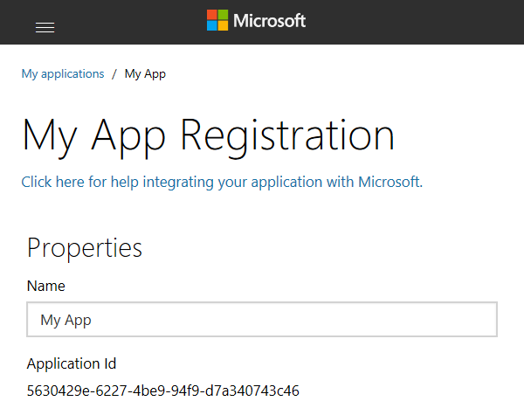
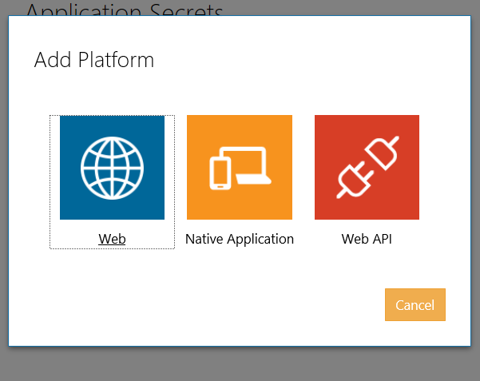
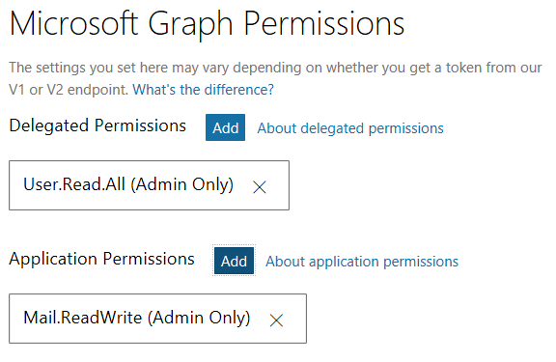
App registration v2.0
Create a new application
https://apps.dev.microsoft.com
A unique Id is created for your app
Add app platform
Web App, SPA, Daemon
Native App
Web API (Office Add-in)
Add permissions for admin consent flows
For delegated access for all users in the organization
For application access
Notes:
Explica Robert

Slide 15
Auth
Microsoft Identity
id_token
access_token
refresh_token
YOUR APP
access_token
MSAL or ADAL
Microsoft Graph
Notes:
Explica Robert

Slide 16
Microsoft graph activities APIs and Microsoft graph devices APIs ​ Activities and cross device experience
Activities​
Get you app activities in the Windows Timeline​
Let customers pick up where they leave off​
Feed is synchronized effortlessly across devices & platforms ​
Activities API​
List, create, replace, delete activities
Devices​
Discover and connect to user's devices​
Remotely launch apps on those devices​
Send messages to your apps on those devices​
Device API​
List devices​
Send commands​
Get command status
Notes:
Añadiría esta: Explica Robert

Slide 17
EL HOL
Como utilizar Graph y no morir en el intento
Extendiendo Office 365 con Microsfoft Graph
Microsoft Graph a fondo
https://github.com/CompartiMOSS/SPS-Office-365-Saturday-Madrid-2018-WorkShop
Como utilizar Graph y no morir en el intento
Notes:
Añadiría esta: Explica Robert

Slide 18
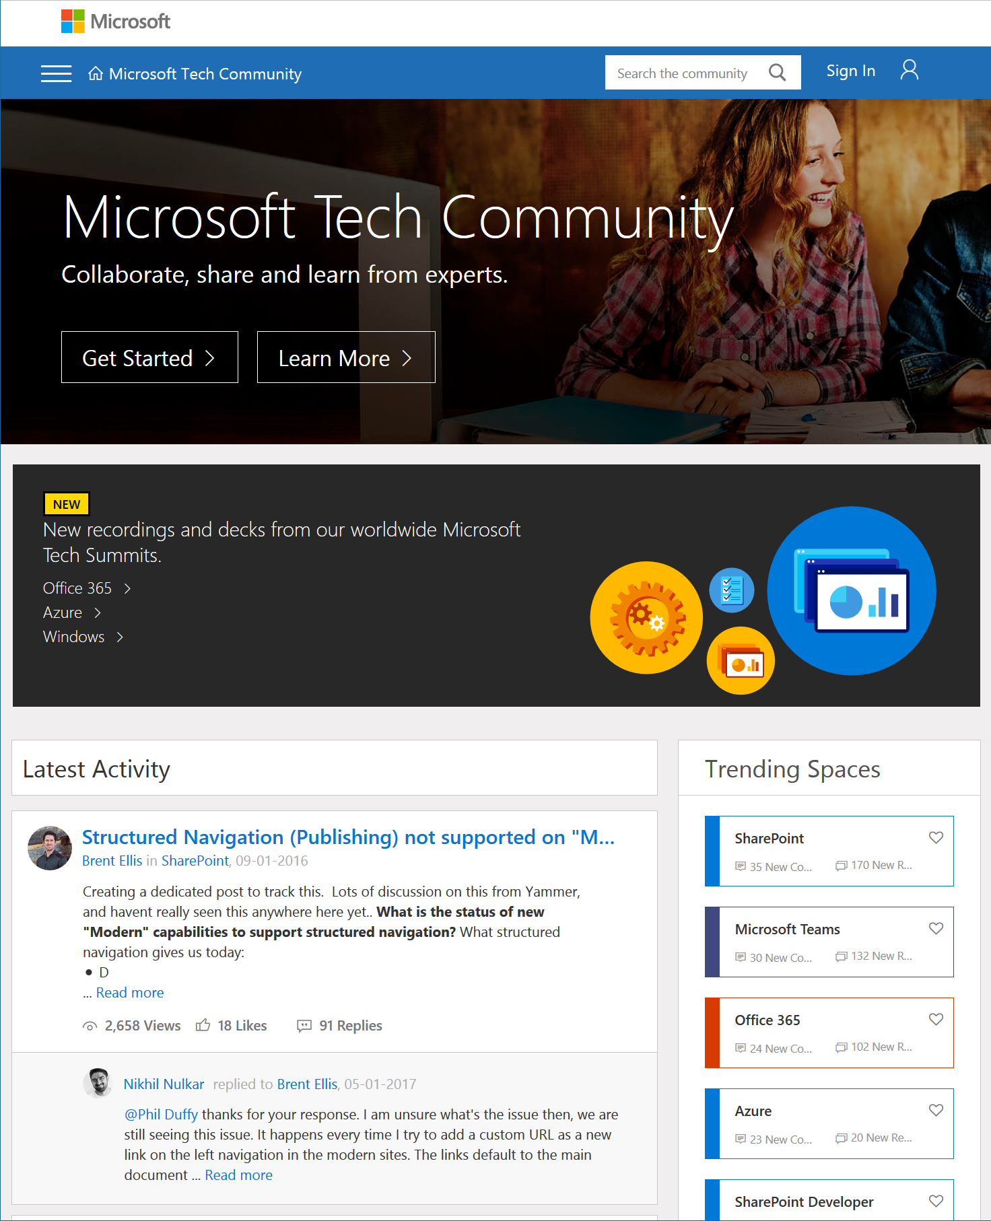
Microsoft Tech Community
techcommunity.microsoft.com
One Microsoft community for IT Pros and tech enthusiasts to learn from experts on Microsoft products
Trusted resource for news, best practices and answers from Microsoft product teams and MVPs
Join today! It’s free – sign in with your Microsoft Account.

Slide 19
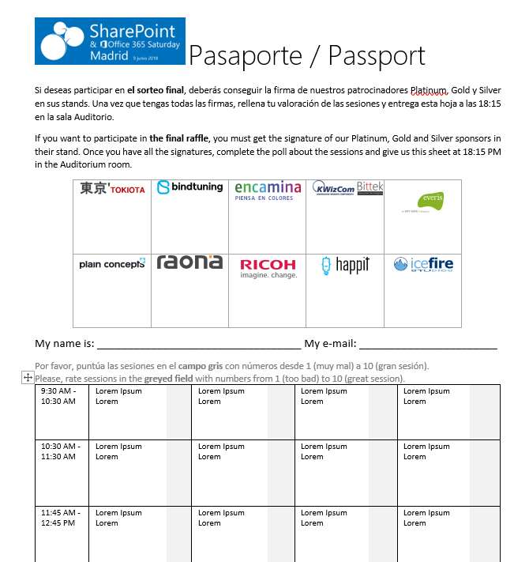


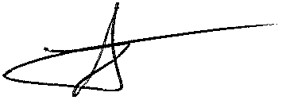



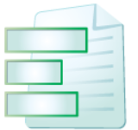
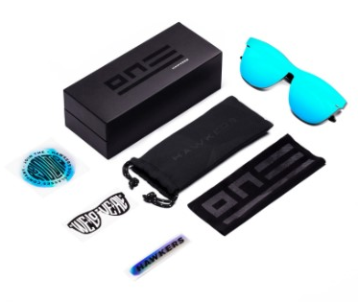





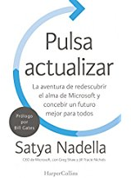

Raffle
Please, fill your SP & Office 365 Saturday Madrid passport if you want to participate.
You can win one of these gifts:
Please, fill your SP & Office 365 Saturday Madrid passport if you want to participate.
You can win one of these gifts:
Odor
Odor@winterfell.com
10
9
2x
2x
8

Slide 20
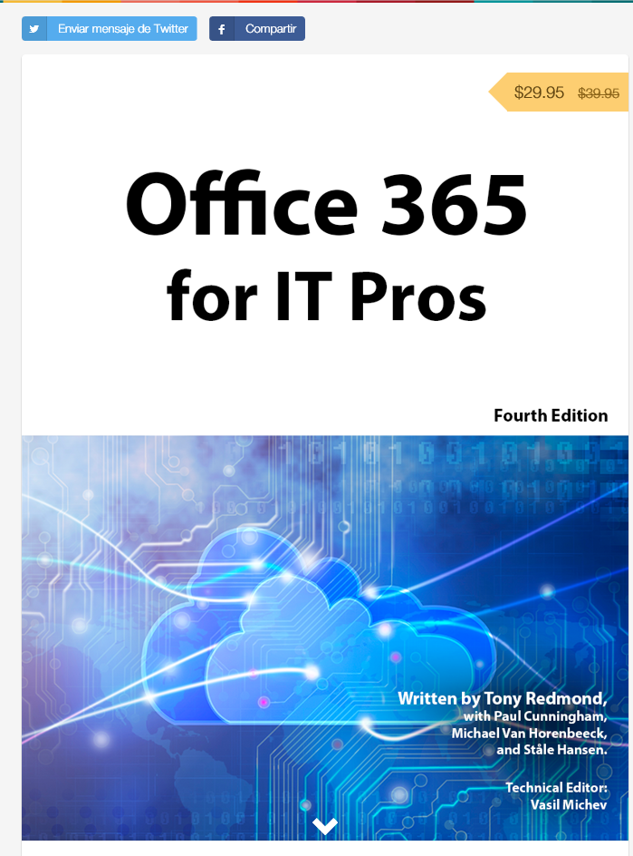
Office 365 for IT Pros
Get a discount of $10 buying the book here: https://gumroad.com/l/O365IT/spsspain

Slide 21
Notes:
This slide is mandatory. Please do not remove and try to use it during Q&A at the end of your session. Thank you!

Slide 22
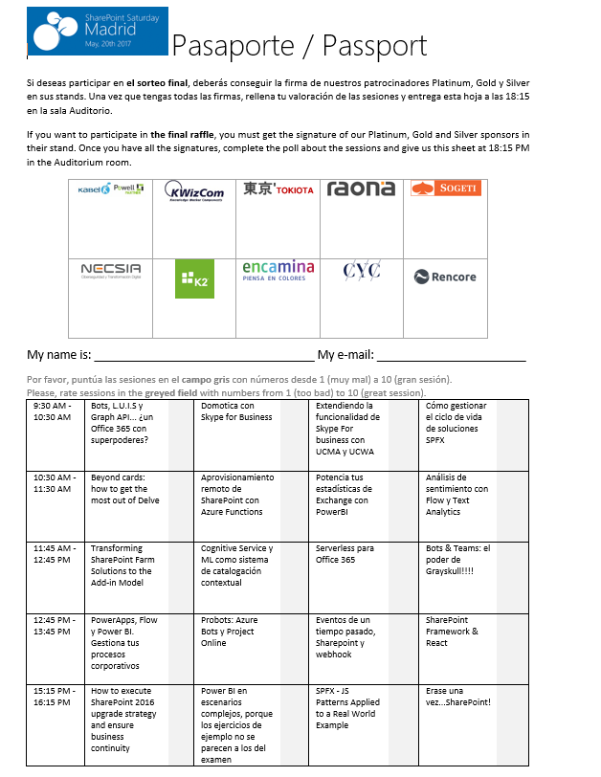
Raffle
Please, fill your SP & Office 365 Saturday Madrid passport if you want to participate.
You can win one of these gifts:
Odor
Odor@winterfell.com
10
9
8

